Slide 1
ACIDS AND BASES

Slide 2
Acids and Bases Reactions
ACID + METAL → SALT + H_{2(g)}
(Eg: Some hydrochloric acid solution is poured onto a strip of nickel metal)
2HCl_{(aq)} + Ni_{(s)} → NiCl_{2(aq)} + H_{2(g)}
2H⁺_{(aq)} + Ni_{(s)} → Ni²⁺_{(aq)} + H_{2(g)}
Observations: Colourless solution added to a silver solid to produce a green solution and bubbles of a colourless, odourless gas/effervescence.

Slide 3
Acids and Bases Reactions
ACID + METAL HYDROXIDE → SALT + H₂O
(Eg: Calcium hydroxide solution is added to a solution of nitric acid)
2HNO_{3(aq)} + Ca(OH)_{2(aq)} → Ca(NO₃)_{2(aq)} + 2H­₂O_{(l)}
H⁺_{(aq)} + OH⁻_{(aq)} → H₂O_{(l)}
Observations: No observable change.

Slide 4
Acids and Bases Reactions
ACID + METAL OXIDE → SALT + H₂O
(Eg: Some solid copper (II) oxide is added to a solution of sulfuric acid)
H₂SO_{4(aq)} + CuO_{(s)} → CuSO_{4(aq)} + H­₂O_{(l)}
2H⁺_{(aq)} + CuO_{(s)} → Cu²⁺_{(aq)} + H₂O_{(l)}
Observations: Colourless solution added to a black solid to produce a blue solution.

Slide 5
Acids and Bases Reactions
ACID + CARBONATE → SALT + H₂O + CO_{2(g)}
(Eg: Hydrochloric acid solution is added to nickel carbonate solid)
2HCl_{(aq)} + NiCO_{3(s)} → NiCl_{2(aq)} + H₂O_{(l)} + CO_{2(g)}
2H⁺_{(aq)} + NiCO_{3(s)} → Ni²⁺_{(aq)} + H₂O_{(l)} + CO_{2(g)}
Observations: Colourless solution added to a green solid to produce a green solution and a colourless, odourless gas/effervescence.

Slide 6
Acids and Bases Reactions
ACID + HYDROGENCARBONATE → SALT + H₂O + CO_{2(g)}
(Eg: Ethanoic acid solution is added to solid zinc hydrogencarbonate)
2CH₃COOH_{(aq)} + Zn(HCO₃)_{2(s)} → Zn²⁺_{(aq)} + 2CH₃COO⁻_{(aq)} + 2H₂O_{(l)} + 2CO_{2(g)}
Observations: Colourless solution added to a white solid to produce a colourless solution and a colourless, odourless gas/effervescence.

Slide 7
Acids and Bases Reactions
ACID + METAL SULFITE → SALT + H₂O + SO_{2(g)}
(Eg: Hydrochloric acid solution and sodium sulphite powder are mixed)
2HCl_{(aq)} + Na₂SO_{3(s)} → 2NaCl_{(aq)} + H₂O_{(l)} + SO_{2(g)}
2H⁺_{(aq)} + Na₂SO_{3(s)} → 2Na⁺ _{(aq)} + H₂O_{(l)} + SO_{2(g)}
Observations: White solid added to a colourless solution to produce a colourless solution and a colourless, pungent gas/effervescence .

Slide 8
Acids and Bases Reactions
BASE + AMMONIUM SALT → SALT + H₂O + NH_{3(g)}
(Eg: A potassium hydroxide solution is mixed with an ammonium chloride solution)
KOH_{(aq)} + NH₄Cl_{(aq)} → KCl_{(aq)} + H₂O_{(l)} + NH_{3(g)}
NH₄⁺_{(aq)} + OH⁻_{(aq)} → H₂O_{(l)} + NH_{3(g)}
Observations: Two colourless solutions added together to produce a colorless, pungent gas/effervescence.

Slide 9
Acids and Bases Reactions
BASE + NON-METAL OXIDE → SALT + H₂O
(Eg: Sulfur dioxide gas is bubbled through a potassium hydroxide solution)
SO_{2(g)} + 2KOH_{(aq) →} K₂SO_{3(aq)} + H₂O_{(l)}
SO_{2(g)} + 2OH⁻ _{(aq) →} SO₃²⁻_{(aq)} + H₂O_{(l)}
Observations: Pungent, colourless gas bubbled through a colourless solution. Pungent odour disappears and colourless solution formed.

Slide 10
Davy Theory
Acids: Have replaceable H (hydrogen could be partly or totally replaced by metals).
eg hydrochloric acid:
2HCl_{(aq)} + Mg_{(s)} → MgCl_{2(aq)} + H_{2(g)}
Bases: Reacted with acids to form salt and water.
eg sodium hydroxide:
NaOH_{(s)} + HNO_{3(aq)} → NaNO_{3(aq)} + H₂O_{(l)}

Slide 11
Arrhenius Theory
Acids: Have H in their formula and produce hydrogen ions (H⁺) when dissolved in water.
eg hydrochloric acid: HCl_{(g)} → H⁺_{(aq)} + Cl⁻_{(aq)}
eg ethanoic acid: CH₃COOH_{(s)} → H⁺_{(aq)} + CH₃COO⁻_{(aq)}
Bases: Have OH in their formula and produce hydroxide ions (OH⁻) when dissolved in water.
eg sodium hydroxide: NaOH_{(s)} → Na⁺_{(aq)} + OH⁻_{(aq)}
eg strontium hydroxide: Sr(OH)_{2(s)} →Sr²⁺_{(aq)}+2OH⁻_{(aq)}

Slide 12
Neutralisation: an acid plus a base produces a neutral solution
(ie H⁺_{(aq)} + OH⁻_{(aq)} → H₂O_{(l)})
Problems with the theory:
Some bases produce OH⁻ ions in solution yet do not have OH in their formula (eg NH₃ and CO₃²⁻).
Restricted to aqueous solutions.
Not all salts are neutral.
Does not allow for the existence of hydronium ions (H₃O⁺).

Slide 13
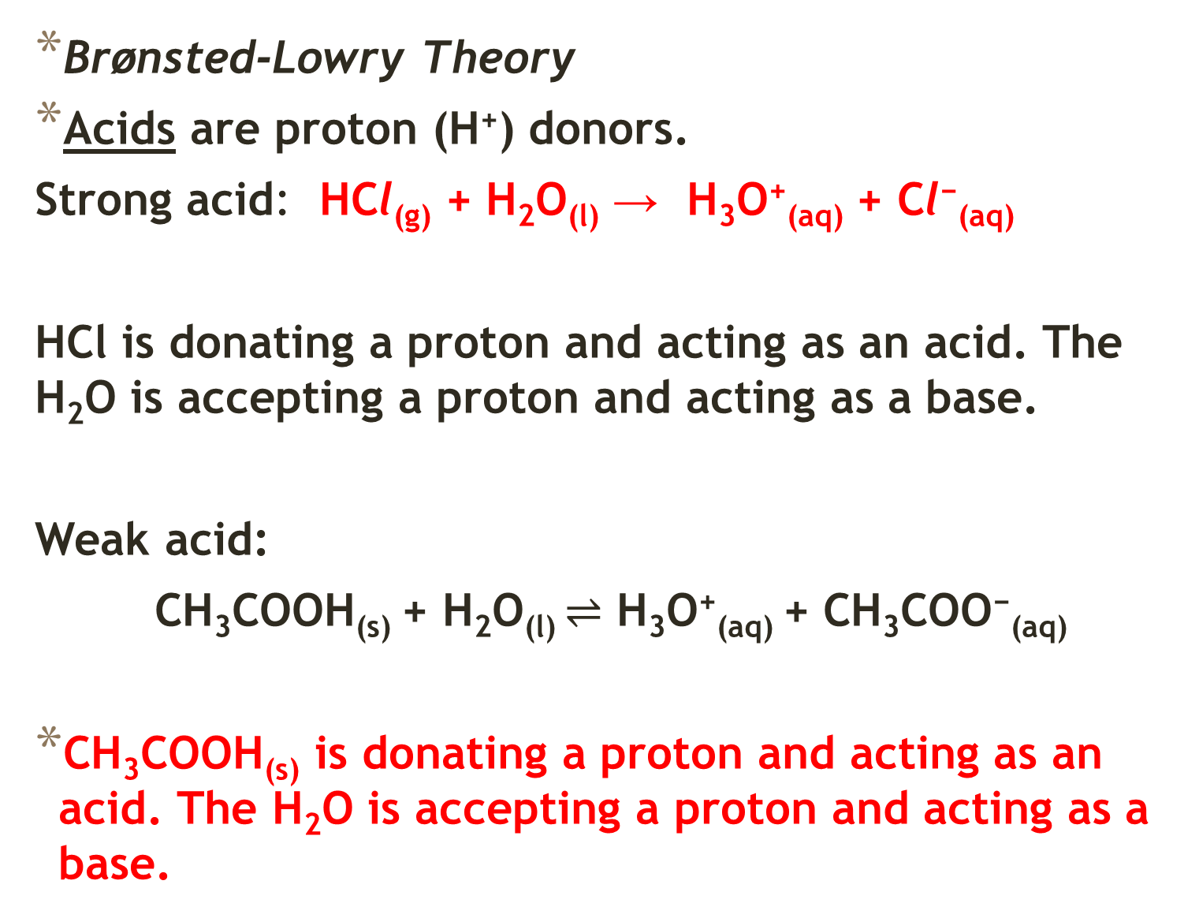
Brønsted-Lowry Theory
Acids are proton (H⁺) donors.
Strong acid: HCl_{(g)} + H₂O_{(l)} → H₃O⁺_{(aq)} + Cl⁻_{(aq)}
HCl is donating a proton and acting as an acid. The H₂O is accepting a proton and acting as a base.
Weak acid:
CH₃COOH_{(s)} + H₂O_{(l)} $⇌$ H₃O⁺_{(aq)} + CH₃COO⁻_{(aq)}
CH₃COOH_{(s)} is donating a proton and acting as an acid. The H₂O is accepting a proton and acting as a base.

Slide 14
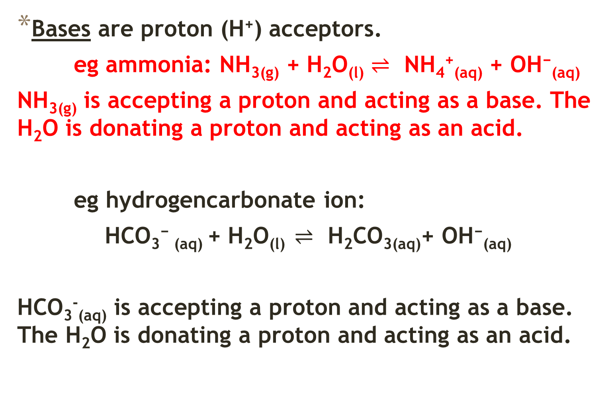
Bases are proton (H⁺) acceptors.
eg ammonia: NH_{3(g)} + H₂O_{(l)} $⇌$ NH₄⁺_{(aq)} + OH⁻_{(aq)}
NH_{3(g)} is accepting a proton and acting as a base. The H₂O is donating a proton and acting as an acid.
eg hydrogencarbonate ion:
HCO₃⁻ _{(aq)} + H₂O_{(l)} $⇌$ H₂CO_{3(aq)}+ OH⁻_{(aq)}
HCO₃⁻_{(aq)} is accepting a proton and acting as a base. The H₂O is donating a proton and acting as an acid.

Slide 15
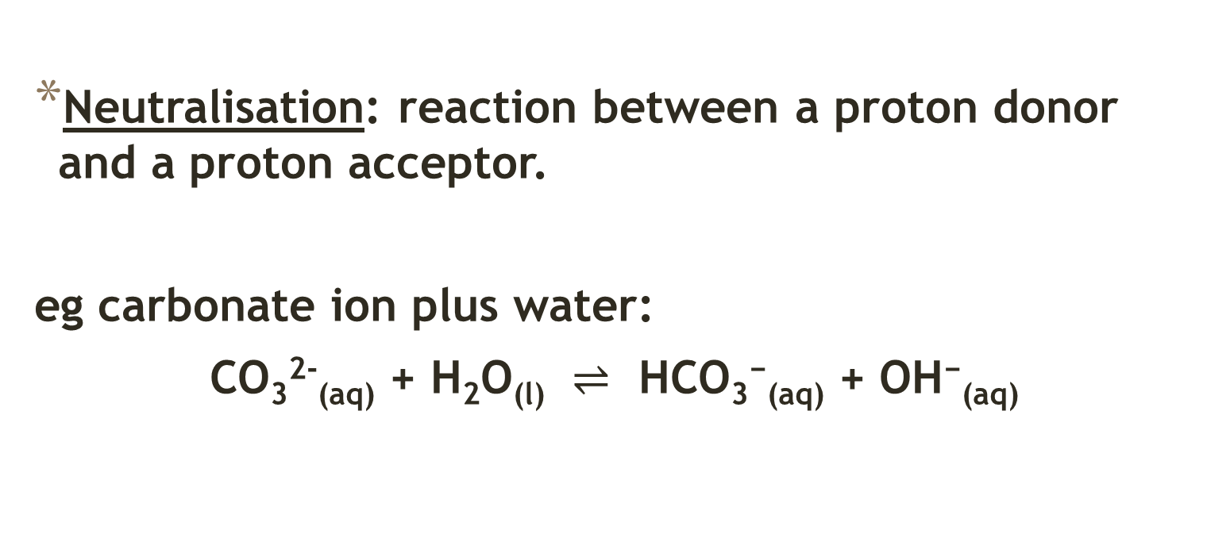
Neutralisation: reaction between a proton donor and a proton acceptor.
eg carbonate ion plus water:
CO₃²⁻_{(aq)} + H₂O_{(l)} $⇌$ HCO₃⁻_{(aq)} + OH⁻_{(aq)}

Slide 16
Conjugate acid- base pairs
Brønsted-Lowry theory recognises the reversibility of proton transfer reactions.
Once an acid has donated a proton it has the potential to act as a base. We say it has formed its conjugate base.
Once a base has accepted a proton it has the potential to act as an acid. We say it has formed its conjugate acid.

Slide 17
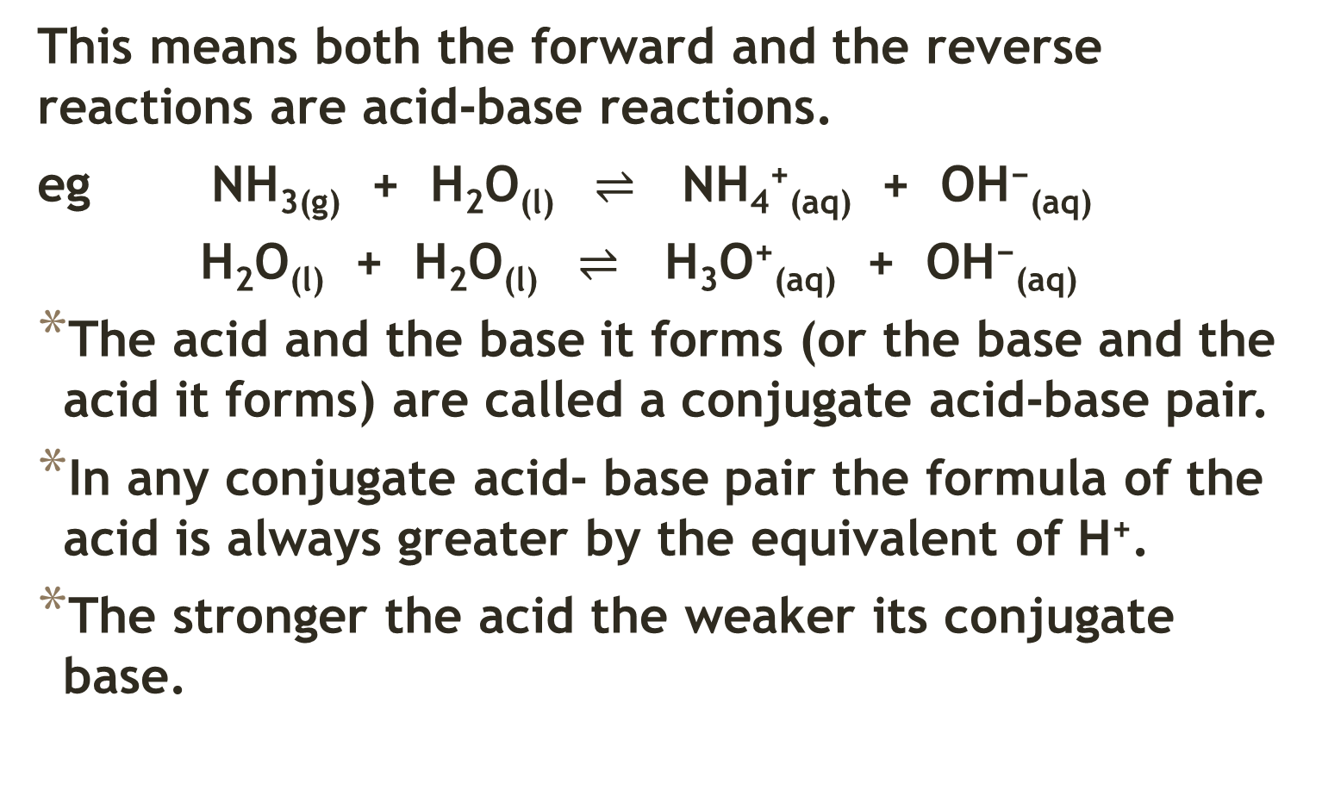
This means both the forward and the reverse reactions are acid-base reactions.
eg NH_{3(g)} + H₂O_{(l)} $⇌$ NH₄⁺_{(aq)} + OH⁻_{(aq)}
H₂O_{(l)} + H₂O_{(l)} $⇌$ H₃O⁺_{(aq)} + OH⁻_{(aq)}
The acid and the base it forms (or the base and the acid it forms) are called a conjugate acid-base pair.
In any conjugate acid- base pair the formula of the acid is always greater by the equivalent of H⁺.
The stronger the acid the weaker its conjugate base.

Slide 18
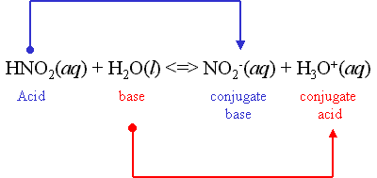

Slide 19
Acidity constant (K_{a}) and acid strength
An acid- base transfer reaction is an example of an equilibrium process. The extent to which an acid ionises in aqueous solutions can be determined from the equilibrium constant K_{a} also known as the acidity constant. It is a measure to which the proton transfer goes to completion.

Slide 20

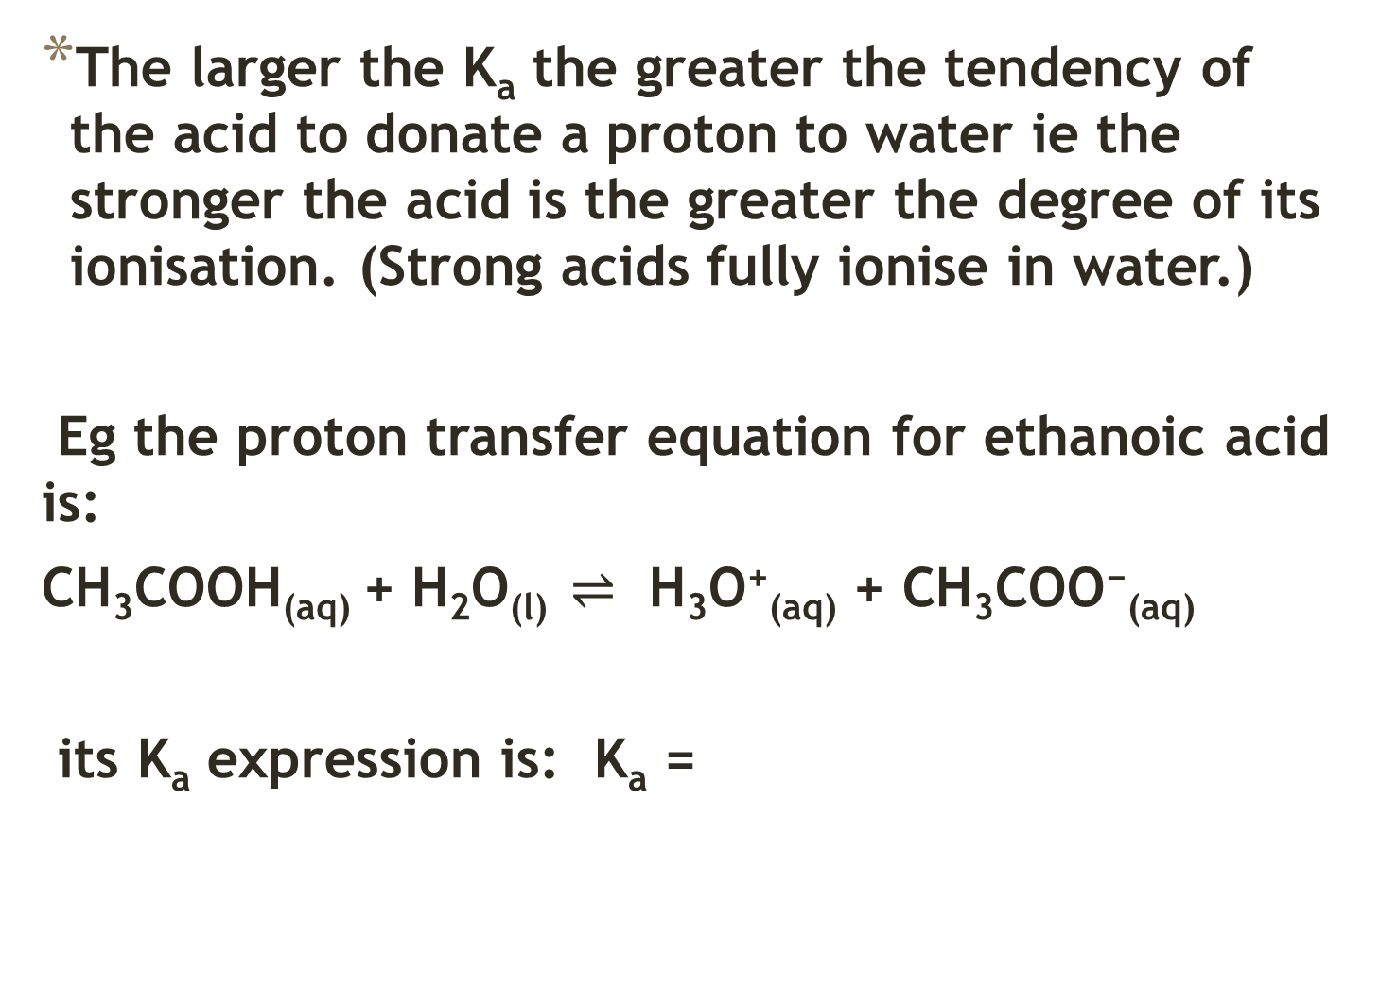
The larger the K_{a} the greater the tendency of the acid to donate a proton to water ie the stronger the acid is the greater the degree of its ionisation. (Strong acids fully ionise in water.)
Eg the proton transfer equation for ethanoic acid is:
CH₃COOH_{(aq)} + H₂O_{(l)} $⇌$ H₃O⁺_{(aq)} + CH₃COO⁻_{(aq)}
its K_{a} expression is: K_{a} =

Slide 21
The K_{a} value at 25°C is 1.8 x 10⁻⁵. This indicates the reaction only proceeds to a very limited extent and only about 1% of ethanoic acid molecules are ionised.
The larger the value of K_{a} the more the equilibrium position favours products, hence the greater the tendency of the acid to form hydronium ions and so the stronger the acid is.
The K_{a} value also indicates the strength of the acid’s conjugate base to accept a proton back from water so, if K_{a} is large (strong acid) its conjugate base is weak. As K_{a} is progressively smaller, the acid is progressively weaker and the conjugate base becomes progressively stronger. (The stronger the acid is the weaker its conjugate-base.)

Slide 22
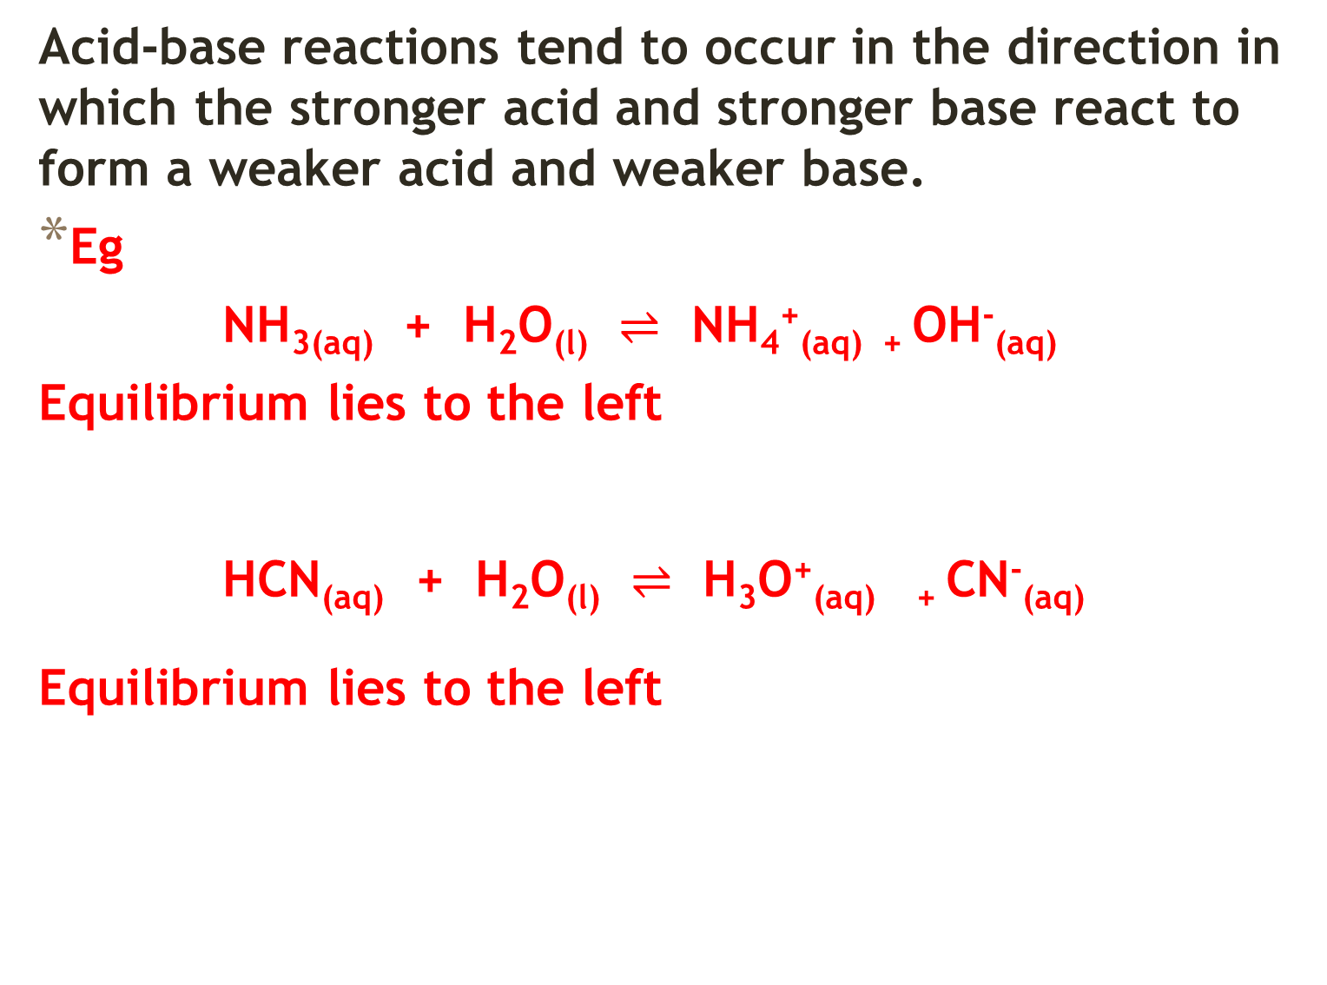
Acid-base reactions tend to occur in the direction in which the stronger acid and stronger base react to form a weaker acid and weaker base.
Eg
NH_{3(aq)} + H₂O_{(l)} $⇌$ NH₄⁺_{(aq) +} OH⁻_{(aq)}
Equilibrium lies to the left
HCN_{(aq)} + H₂O_{(l)} $⇌$ H₃O⁺_{(aq) +} CN⁻_{(aq)}
Equilibrium lies to the left

Slide 23
Monoprotic acids can donate only one proton (hydrogen ion) per molecule. Eg HCl; CH₃COOH; HNO₃
While weak monoprotic acids produce fewer hydrogen ions in solution than strong acids, they react to the same extent with bases, providing that the concentration is the same.

Slide 24
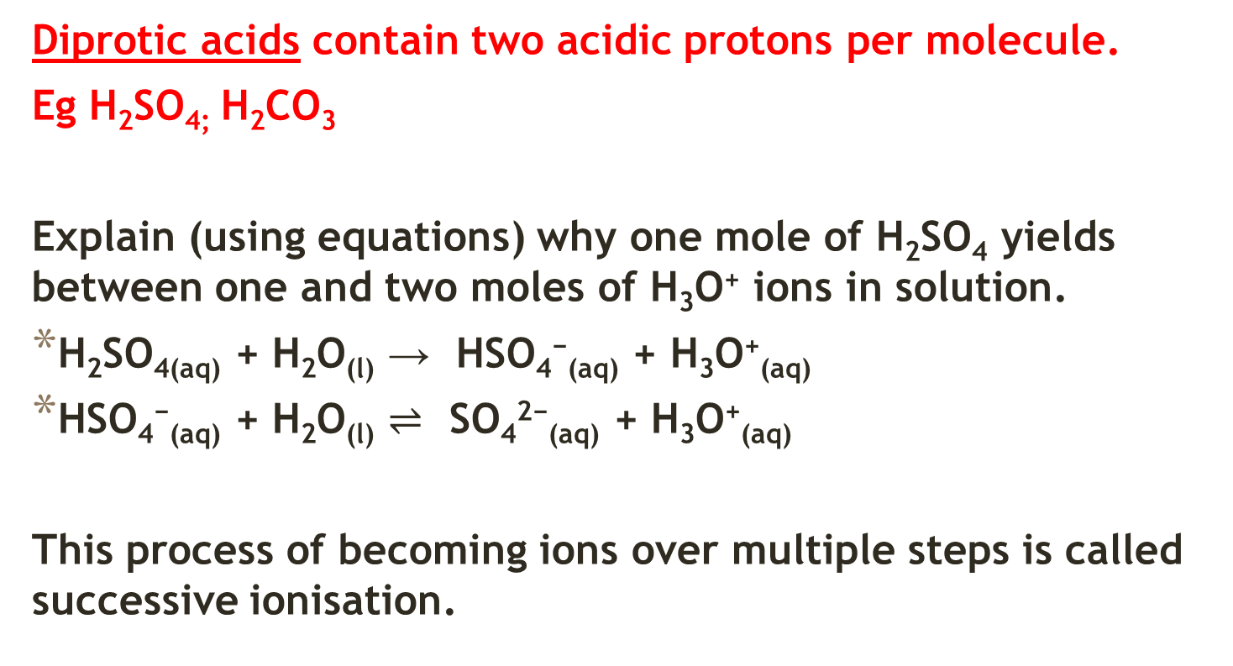
Diprotic acids contain two acidic protons per molecule.
Eg H₂SO_{4;} H₂CO₃
Explain (using equations) why one mole of H₂SO₄ yields between one and two moles of H₃O⁺ ions in solution.
H₂SO_{4(aq)} + H₂O_{(l)} → HSO₄⁻_{(aq)} + H₃O⁺_{(aq)}
HSO₄⁻_{(aq)} + H₂O_{(l)} $⇌$ SO₄²⁻_{(aq)} + H₃O⁺_{(aq)}
This process of becoming ions over multiple steps is called successive ionisation.

Slide 25
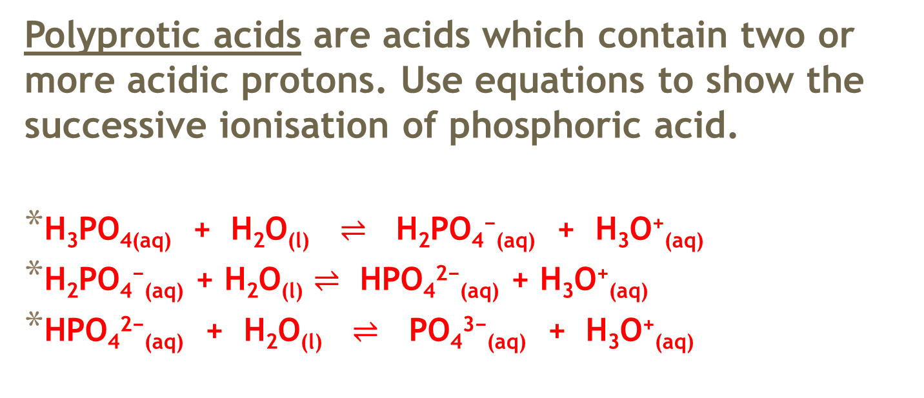
Polyprotic acids are acids which contain two or more acidic protons. Use equations to show the successive ionisation of phosphoric acid.
H₃PO_{4(aq)} + H₂O_{(l)} $⇌$ H₂PO₄⁻_{(aq)} + H₃O⁺_{(aq)}
H₂PO₄⁻_{(aq)} + H₂O_{(l)} $⇌$ HPO₄²⁻_{(aq)} + H₃O⁺_{(aq)}
HPO₄²⁻_{(aq)} + H₂O_{(l)} $⇌$ PO₄³⁻_{(aq)} + H₃O⁺_{(aq)}

Slide 26
Acid-Base Properties of Salts
When an acid reacts with a base, a salt and water are produced. Although this is called a neutralisation reaction, the salt formed in the reaction is not always neutral.
The acid-base properties of the salt can be understood in terms of Bronsted-Lowry theory.
If one of the ions present in the salt reacts with water acting as a proton donor then its solutions will be acidic.
If one of the ions present reacts with water acting as a proton acceptor then its solution is basic.
The reaction of the ions with water is also known as hydrolysis.

Slide 27
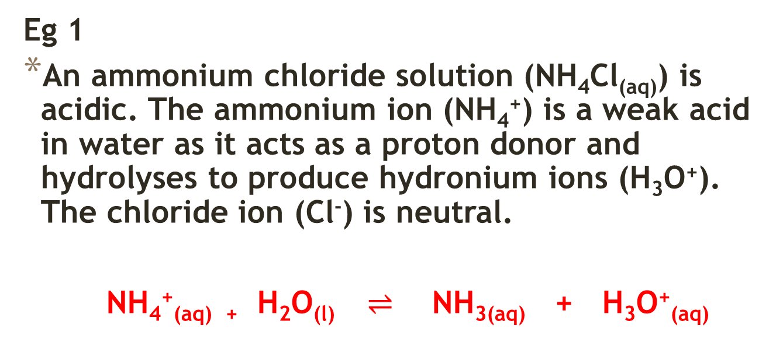
Eg 1
An ammonium chloride solution (NH₄Cl_{(aq)}) is acidic. The ammonium ion (NH₄⁺) is a weak acid in water as it acts as a proton donor and hydrolyses to produce hydronium ions (H₃O⁺). The chloride ion (Cl⁻) is neutral.
NH₄⁺_{(aq) +} H₂O_{(l)} $⇌$ NH_{3(aq)} + H₃O⁺_{(aq)}

Slide 28
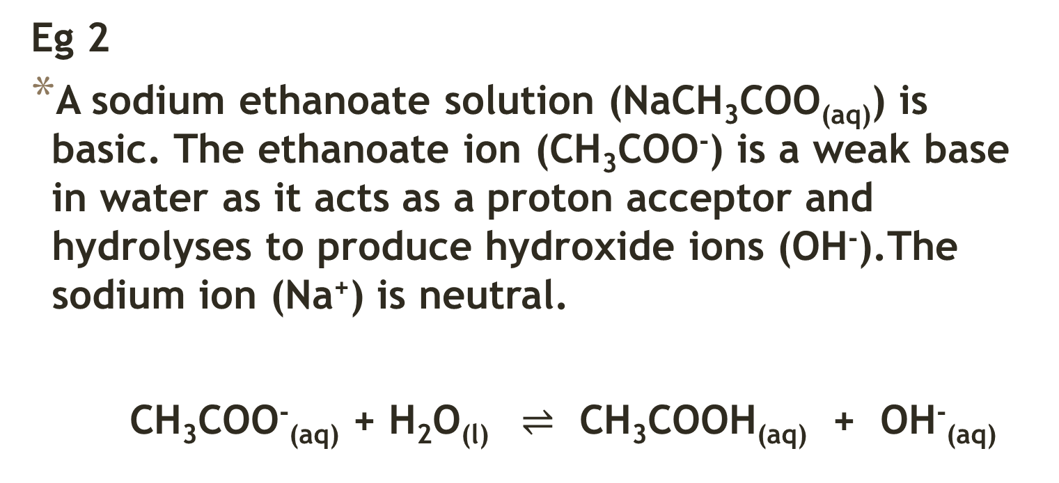
Eg 2
A sodium ethanoate solution (NaCH₃COO_{(aq)}) is basic. The ethanoate ion (CH₃COO⁻) is a weak base in water as it acts as a proton acceptor and hydrolyses to produce hydroxide ions (OH⁻).The sodium ion (Na⁺) is neutral.
CH₃COO⁻_{(aq)} + H₂O_{(l)} $⇌$ CH₃COOH_{(aq)} + OH⁻_{(aq)}

Slide 29
Summary
The table below classifies common ions according to whether they cause aqueous solutions to be acidic, basic or neutral.
Type of Ion | Acidic | Basic | Neutral
Anions | Anions produced in first stage of ionisation of polyprotic acids: HSO₄⁻, H₂PO₄⁻ | Anions from weak acids: F⁻, CO₃²⁻, HS⁻, S²⁻, HPO₄²⁻, PO₄³⁻, HCO₃⁻, CH₃COO⁻ , SO₄²⁻ | Anions from strong acids: Cl⁻, Br⁻, I⁻, NO₃⁻
Cations | NH₄⁺ | Not common | Li⁺, Na⁺, K⁺, Mg²⁺, Ca²⁺, Ba²⁺

Slide 30
Predict whether aqueous solutions of the following salts will be acidic, basic or neutral and justify your choice by writing suitable chemical equations.
Ammonium nitrate
Calcium hydrogencarbonate
Potassium ethanoate
Magnesium bromide
Calcium hydrogensulfate

Slide 31
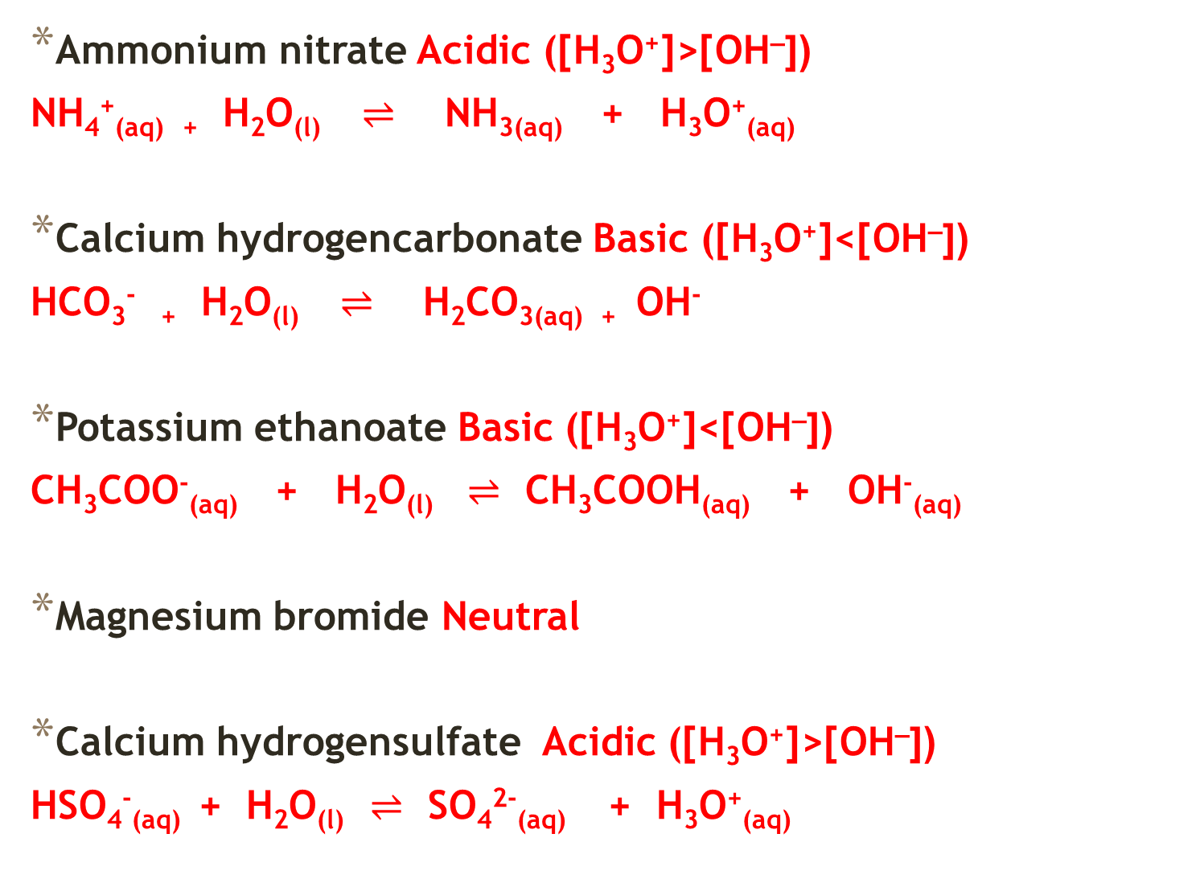
Ammonium nitrate Acidic ([H₃O⁺]>[OH–])
NH₄⁺_{(aq) +} H₂O_{(l)} $⇌$ NH_{3(aq)} + H₃O⁺_{(aq)}
Calcium hydrogencarbonate Basic ([H₃O⁺]<[OH–])
HCO₃⁻ ₊ H₂O_{(l)} $⇌$ H₂CO_{3(aq) +} OH⁻
Potassium ethanoate Basic ([H₃O⁺]<[OH–])
CH₃COO⁻_{(aq)} + H₂O_{(l)} $⇌$ CH₃COOH_{(aq)} + OH⁻_{(aq)}
Magnesium bromide Neutral
Calcium hydrogensulfate Acidic ([H₃O⁺]>[OH–])
HSO₄⁻_{(aq)} + H₂O_{(l)} $⇌$ SO₄²⁻_{(aq)} + H₃O⁺_{(aq)}

Slide 32
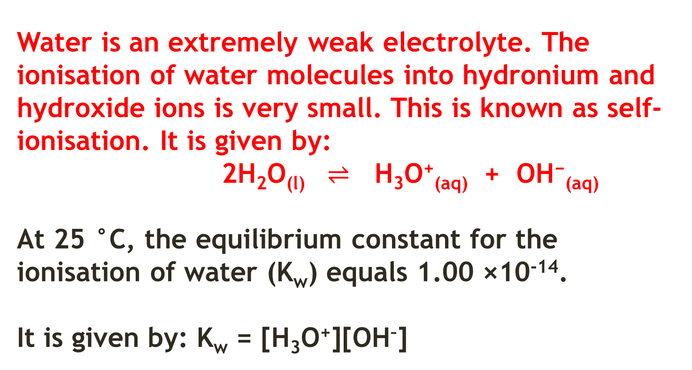
Self- Ionisation of Water, Kw and pH
Water is an extremely weak electrolyte. The ionisation of water molecules into hydronium and hydroxide ions is very small. This is known as self-ionisation. It is given by:
2H₂O_{(l)} $⇌$ H₃O⁺_{(aq)} + OH⁻_{(aq)}
At 25 °C, the equilibrium constant for the ionisation of water (K_{w}) equals 1.00 ×10⁻¹⁴.
It is given by: K_{w} = [H₃O⁺][OH–]

Slide 33
In water or any solution where H₃O⁺ and OH⁻ have the same concentration, the solution is said to be neutral.
[H₃O⁺] = [OH–] = 1.00 ×10⁻⁷ mol L⁻¹ at 25 °C.
From this:
An acidic solution must have [H₃O⁺] > [OH–] and a basic solution must have [H₃O⁺] < [OH–]. Also, since [H₃O⁺] × [OH–] = 1.00 ×10⁻¹⁴ for all solutions at 25 °C, the concentration of one of these ions can be calculated given the concentration of the other.

Slide 34
Calculate the concentration of hydronium ions in a 0.001 mol L⁻¹ NaOH solution.
[OH–] = [NaOH] = 1 x 10⁻³ mol L⁻¹
[H₃O⁺] × [OH–] = 1.00 ×10⁻¹⁴
[H₃O⁺] = 1.00 ×10⁻¹⁴/ 1 x 10⁻³
= 1.00 x 10 ⁻¹¹ mol L⁻¹

Slide 35
Eg. Calculate the concentration of hydroxide and hydrogen ions in a solution made by dissolving 2.34 g of Ba(OH)₂ solid in 543 mL of water.
[OH–] = 5.03 x 10⁻²
[H⁺] = 1.99 x 10⁻¹³

Slide 36
pH
pH is a number indicating how acidic or basic a solution is. It was developed by Søren Sørenson. It is related to [H₃O⁺] through the expression:
pH = –log₁₀[H₃O⁺].
A pH value below 7 is acidic, while a pH value above 7 is basic and pH 7 is neutral.

Slide 37
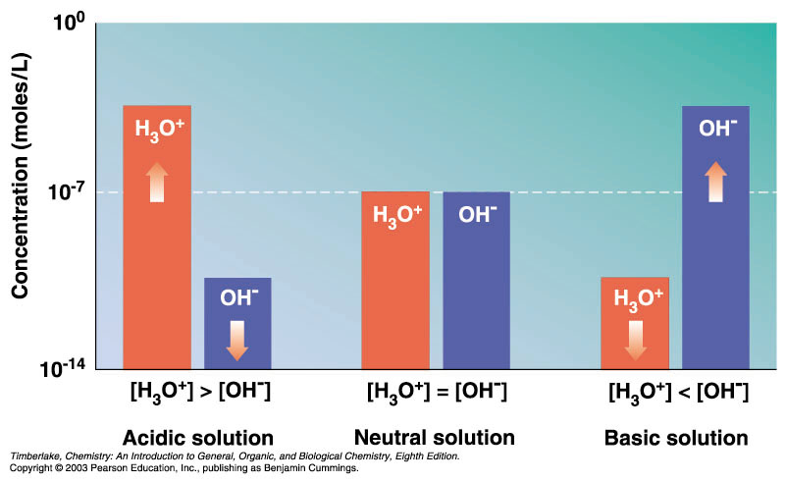
Acidic solution
[H⁺ ] > [OH⁻ ]
Neutral solution
[H⁺ ] = [OH⁻ ]
Basic solution
[H⁺ ] < [OH⁻ ]
Timberlake, Fig 9.3

Slide 38
On the pH scale, values below 7 are acidic, a value of 7 is neutral, and values above 7 are basic.
Marieb, 2.12

Slide 39
Marieb, Fig 26.11

Slide 40
Calculate the pH of a 0.00700 mol L⁻¹ solution of H₂SO₄ (assuming complete ionisation)
H₂SO_{4(aq)} → 2H⁺_{(aq)} + SO₄²⁻_{(aq)}
[H⁺] = 2 x 0.007 = 0.014 mol L⁻¹
pH = - log [0.014] = 1.85

Slide 41
Calculate the pH of a 0.00500 mol L⁻¹ solution of NaOH.
NaOH_{(aq)} → Na⁺_{(aq)} + OH⁻_{(aq)}
Complete ionisation produces 0.00500 mol L⁻¹ OH⁻ ions
[H⁺] = 1.00 x 10⁻¹⁴/0.00500 = 2 x 10⁻¹² mol L⁻¹
pH = - log [2 x 10⁻¹² ] = 11.7

Slide 42
pH can be measured using an indicator solution (a specific weak acid that changes colour over a range of pH), indicator paper or a pH meter (which is much more precise, if used correctly).
A pH meter measures the voltage difference across two electrodes placed in the solution.

Slide 43
The self-ionisation of water is an endothermic process. An increase in temperature will favour the endothermic (forward) reaction which would result in an increased equilibrium constant. (eg at 40 °C, K_{w} = 2.916 ×10⁻¹⁴).
Similarly, at lower temperatures, the exothermic (reverse) reaction is favoured and so the equilibrium constant is reduced (eg at 10 °C, K_{w} = 2.93 ×10⁻¹⁵).

Slide 44
It is important to remember that even though pure water at temperatures above 40 °C has a pH less than 7, it is not acidic (this is because a neutral pH of 7 only applies at 25 °C). Pure water at, whatever temperature, is always neutral because the [H₃O⁺] = [OH—].

Slide 45
Buffers
A buffer is a solution that resists changes in its pH when small amounts of an acid or base are added.
It is made up of a mixture of a weak acid and its conjugate base or a weak base and its conjugate acid.
They are often prepared by adding the salt of the conjugate acid or base to the weak base or acid (respectively).

Slide 46
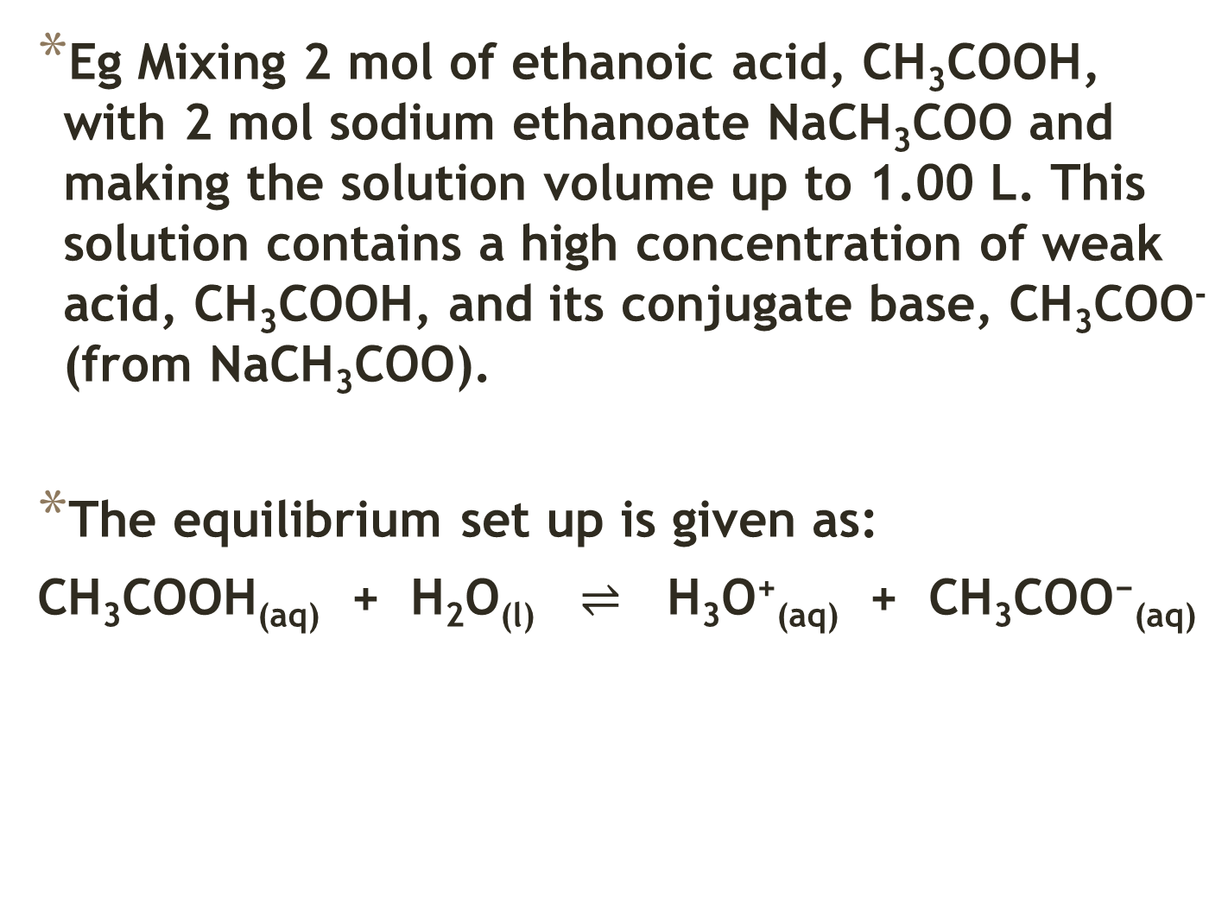
Eg Mixing 2 mol of ethanoic acid, CH₃COOH, with 2 mol sodium ethanoate NaCH₃COO and making the solution volume up to 1.00 L. This solution contains a high concentration of weak acid, CH₃COOH, and its conjugate base, CH₃COO⁻ (from NaCH₃COO).
The equilibrium set up is given as:
CH₃COOH_{(aq)} + H₂O_{(l)} $⇌$ H₃O⁺_{(aq)} + CH₃COO⁻_{(aq)}

Slide 47
If acid is added, the system adjusts (according to Le Châtelier’s Principle) by shifting the equilibrium to the left.
In this case, the acetate ions will react with the excess H₃O⁺ to keep the overall [H₃O⁺] relatively constant.
Similarly, if a base is added, the system adjusts by shifting the equilibrium to the right to replace the H₃O⁺ which reacted with the OH–.

Slide 48
In both these cases, the acid or base can be consumed without a great alteration to the [H₃O⁺] in the original mixture.
As a result, the pH of the mixture does not alter appreciably.
Of course, buffer solutions have their limits and eventually if enough acid or base is added, the pH will change significantly.

Slide 49
Explain buffering using Collision Theory
Using the ethanoic/ sodium ethanoate buffer system:
If acid is added to the system this increases the H⁺/ H₃O⁺ concentration.
This increases the frequency of collisions between H₃O⁺ and CH₃COO‒ and so increases the rate of the reverse reaction relative to the forward reaction.
This will consume H⁺/ H₃O⁺ and reduce their concentration.
(While this occurs the concentration of the reactants is increasing and so the rate of the forward reaction increases until the rates of the forward and reverse reactions are the same and) equilibrium is re-established where H₃O⁺ concentration is very close to what it was originally maintaining pH.

Slide 50
If base is added to the system this decreases the H⁺/ H₃O⁺ concentration.
This reduces the frequency of collisions between H₃O⁺ and CH₃COO‒ and so reduces the rate of the reverse reaction relative to the forward reaction.
This will increase the H⁺/ H₃O⁺ concentration.
(The rate of the reverse reaction then increases until the rates of the forward and reverse reactions are the same and) equilibrium is re- established where H₃O⁺ concentration is very close to what it was originally maintaining pH.

Slide 51
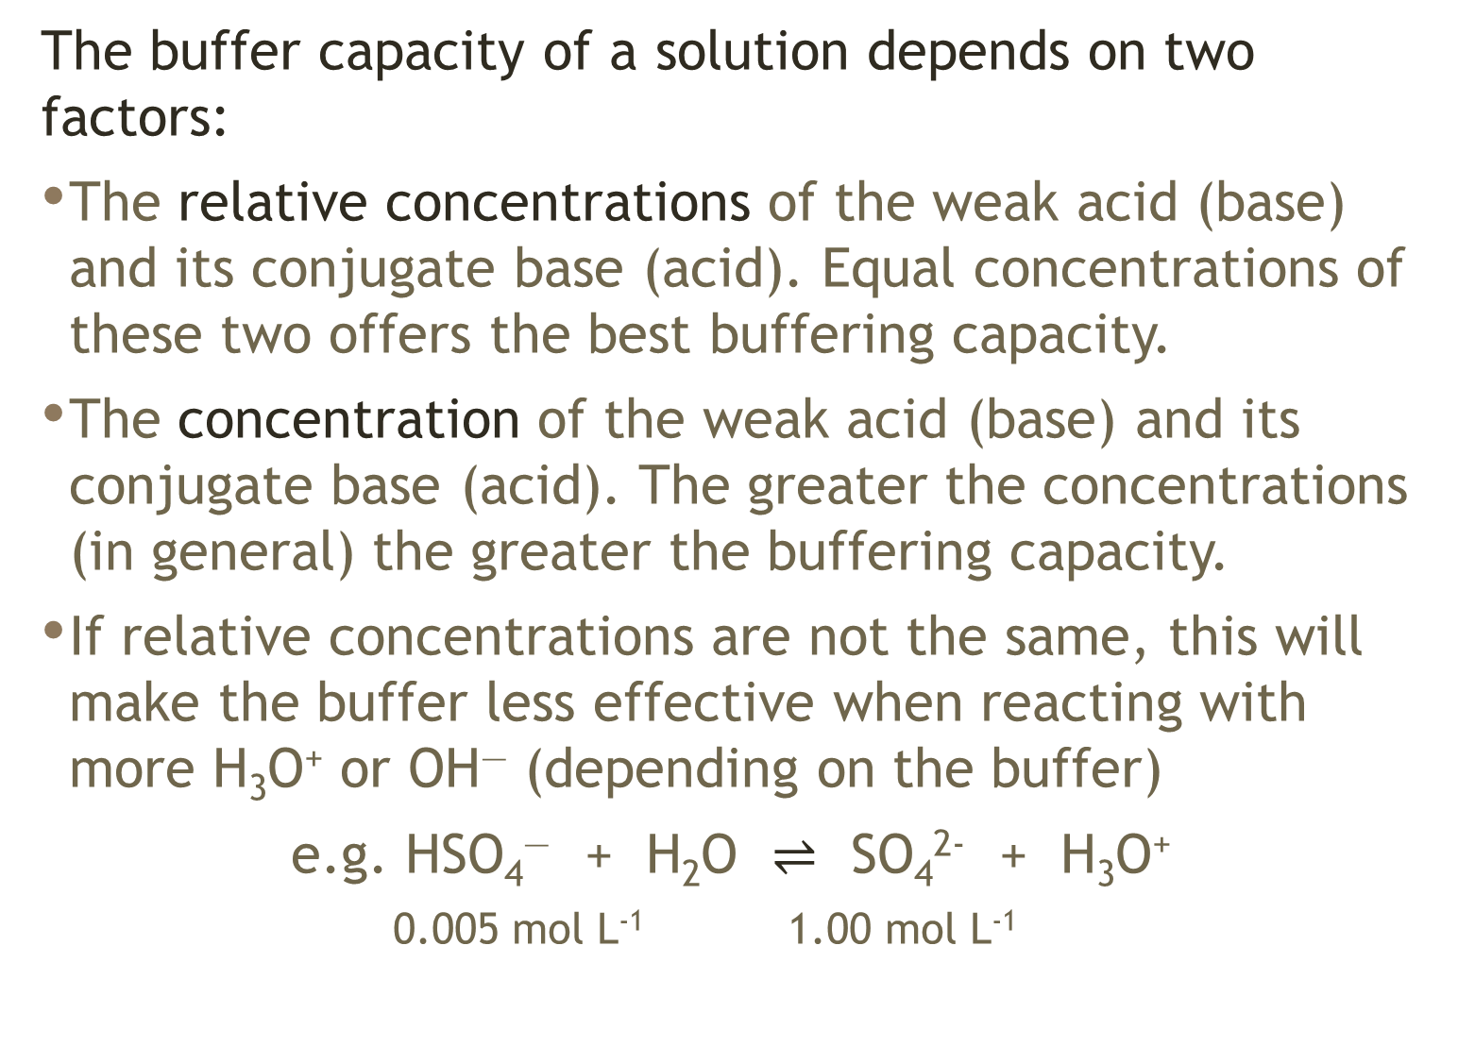
The buffer capacity of a solution depends on two factors:
The relative concentrations of the weak acid (base) and its conjugate base (acid). Equal concentrations of these two offers the best buffering capacity.
The concentration of the weak acid (base) and its conjugate base (acid). The greater the concentrations (in general) the greater the buffering capacity.
If relative concentrations are not the same, this will make the buffer less effective when reacting with more H₃O⁺ or OH― (depending on the buffer)
e.g. HSO₄― + H₂O $⇌$ SO₄²⁻ + H₃O⁺
0.005 mol L⁻¹ 1.00 mol L⁻¹
Notes:
In example above, adding H₃O⁺ will be counteracted by excess SO₄²⁻, but if OH⁻ is added, limited amount of HSO₄⁻ to increase [H₃O⁺]

Slide 52
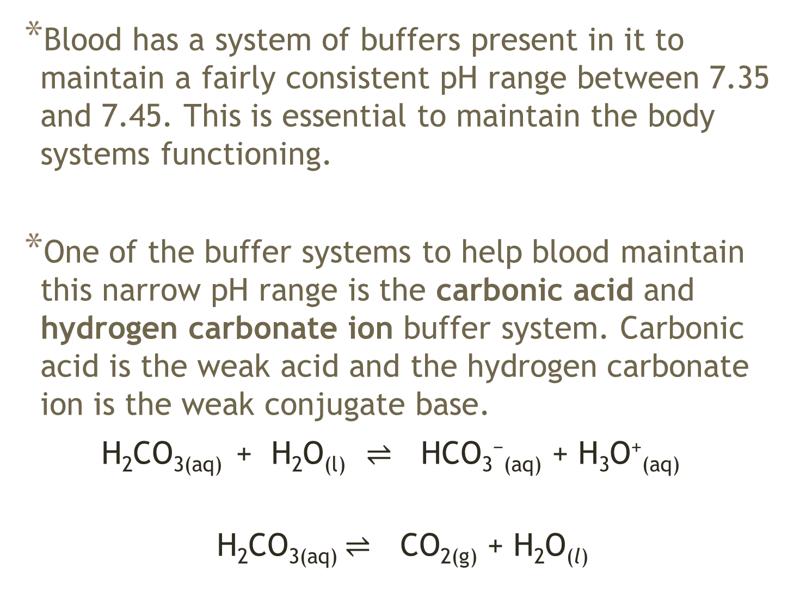
Blood has a system of buffers present in it to maintain a fairly consistent pH range between 7.35 and 7.45. This is essential to maintain the body systems functioning.
One of the buffer systems to help blood maintain this narrow pH range is the carbonic acid and hydrogen carbonate ion buffer system. Carbonic acid is the weak acid and the hydrogen carbonate ion is the weak conjugate base.
H₂CO_{3(aq)} + H₂O_{(l)} $⇌$ HCO₃⁻_{(aq)} + H₃O⁺_{(aq)}
H₂CO_{3(aq)} $⇌$ CO_{2(g)} + H₂O_{(l)}

Slide 53
If excess H⁺ is present in the blood this is reduced as equilibrium shifts to the left as the HCO₃‒ reacts with the excess H₃O⁺. If blood becomes basic, [H₃O⁺] falls too low, equilibrium shifts to the right producing more H₃O⁺.
An enzyme found in blood called carbonic anhydrase catalyses the formation of carbonic acid from carbon dioxide which ensures the equilibrium adjusts quickly to changes in H₂CO_{3(aq)} or CO_{2(aq).}
The H₂CO₃/HCO₃–/CO₂ buffer system is particularly useful because it allows the excess H₃O⁺ to exit the body through the lungs as CO₂.

Slide 54
Another blood buffer system is the dihydrogenphosphate and hydrogenphosphate, H₂PO₄–/HPO₄²⁻ buffer system.

Slide 55
Acid-Base Titrations
Acid- base titrations (also called volumetric analysis) are an analytical procedure often used to determine the concentration of a solution or the amount of a particular substance present.
The concentration of one solution must be accurately known. This is called the standard solution. The purpose of the titration is to determine the concentration of the acid or base in the unknown solution.

Slide 56
Five main pieces of equipment are used in titrations:
Pipette – used to accurately deliver a known volume (aliquot) of liquid. It is rinsed with the liquid to be delivered from it prior to use.
Burette – used to accurately deliver a variable volume (titre) of liquid.
It is rinsed with the liquid to be delivered from it prior to use.
Volumetric flask – used to prepare an accurately known volume of solution.
It is rinsed with de-ionised water prior to use.
Analytical balance – used to weigh out an accurately known mass.
Conical flask – used to hold the solutions during the titration. It is rinsed with de-ionised water prior to use.

Slide 57
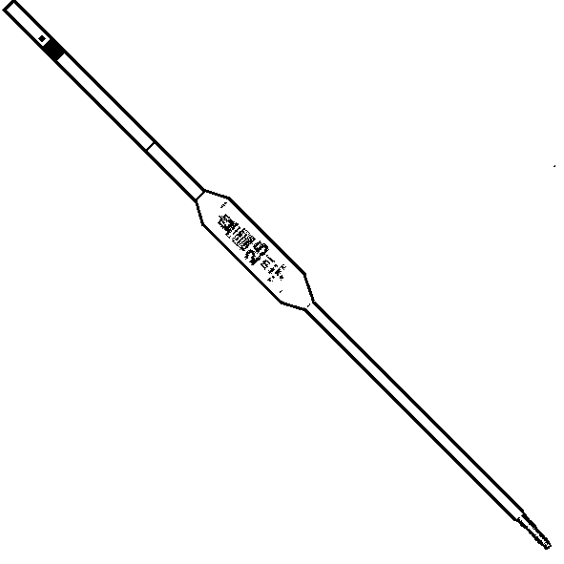
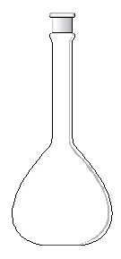
Pipette
Volumetric flask

Slide 58
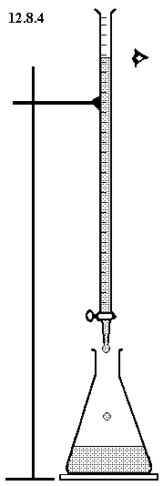
Burette
Conical flask

Slide 59
In the titration process, an aliquot of the standard solution is added to a conical flask.
A titre of the unknown solution is then carefully added from a burette into the conical flask until the reaction between the acid and base is complete.
This theoretical point in the titration when neither acid nor base remain is called the equivalence point.
The equilvalence point occurs when stoichiometrically equivalent amounts of acid and base (reactants) have reacted.

Slide 60
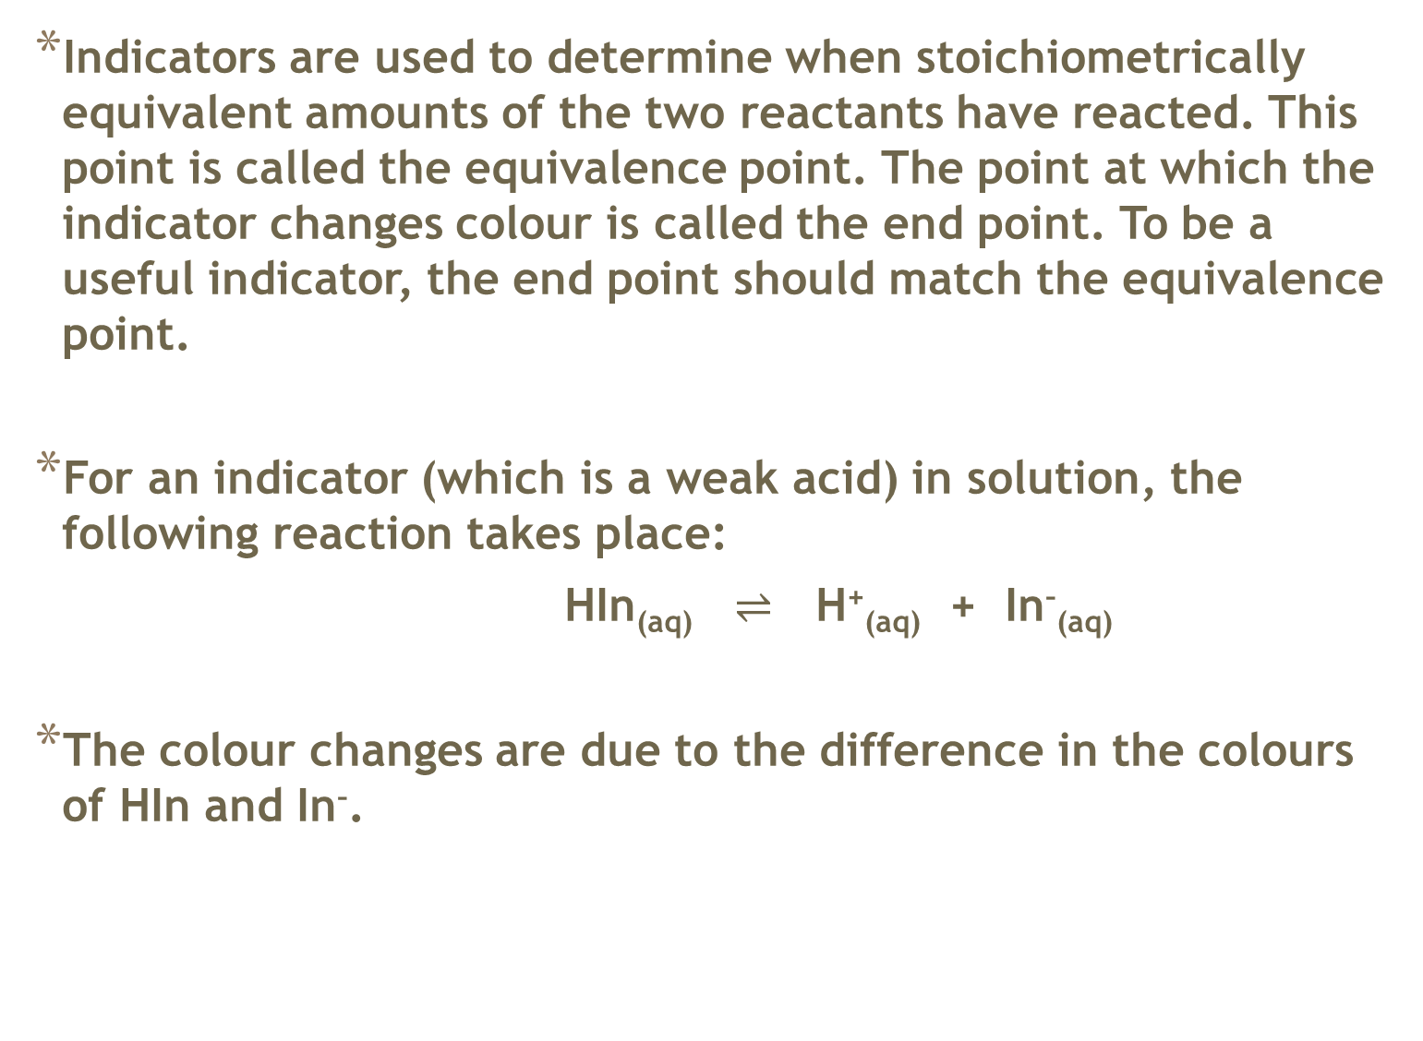
Indicators are used to determine when stoichiometrically equivalent amounts of the two reactants have reacted. This point is called the equivalence point. The point at which the indicator changes colour is called the end point. To be a useful indicator, the end point should match the equivalence point.
For an indicator (which is a weak acid) in solution, the following reaction takes place:
HIn_{(aq)} $⇌$ H⁺_{(aq)} + In–_{(aq)}
The colour changes are due to the difference in the colours of HIn and In–.

Slide 61
A standard solution has an accurately known concentration. A primary standard solution is used to determine the concentration of a secondary standard solution. A primary standard solution should possess the following characteristics:

Slide 62
Has a high degree of purity and a known formula.
The reactions it is involved in are known.
It must be stable. That is, it should not decompose in air, react with oxygen, carbon dioxide or other gases in the air
It must not absorb water from the atmosphere. That is, it is not hygroscopic (absorbs water from the atmosphere) or deliquescent (absorbs so much water that it eventually dissolves in the water it absorbs).
It should have a relatively high formula mass to minimize weighing errors (percentage uncertainty is minimized).

Slide 63
Common primary standards used in acid-base titrations include:
anhydrous sodium carbonate
oxalic acid (H₂C₂O₄)
potassium hydrogenphthalate (KHC₈H₄O₄).

Slide 64
When performing titrations, a practice run is always performed and at least three trials which should agree to within ±0.2 mL (at least two of them). The practice run is never used in the calculating of the average titre volume.

Slide 65
The titration calculation
Eg 20.00 mL aliquots of hydrochloric acid solution are titrated with 9.039 x 10⁻² mol L⁻1sodium carbonate solution. Several titrations were performed and the volumes of sodium carbonate solution used were 19.45 mL, 18.90 mL, 18.77 mL and 18.85 mL. What is the concentration of the hydrochloric acid in the solution?
[HCl] = 1.703 x 10⁻¹ mol L⁻¹

Slide 66
In a back titration, a known volume of an excess reactant is added to the reactant being analysed. A titration is then carried out to determine the amount of excess reactant remaining after the reaction.
Eg Magnesium oxide is not very soluble in water, and is difficult to titrate directly. Its purity can be determined by use of the back titration method. 4.06 g of impure magnesium oxide was completely dissolved in 100.0 mL of hydrochloric acid, of concentration 2.00 mol L⁻¹ (in excess). The excess acid required 19.7 mL of sodium hydroxide (0.200 mol L⁻¹) for neutralisation. Determine the percentage purity of the magnesium oxide in the original sample.
Purity MgO = 97.3%

Slide 67
The Products of Neutralisation Reactions
Not all equivalency points of acid-base reactions will be neutral. Only the reaction between a strong acid and a strong base will produce a neutral solution. As such, the choice of indicator is very important. Below is a list of common indicators and their useful pH range.

Slide 68
Indicator | Colour in Acid | Colour in Base | pH Range
Universal indicator | Red | Purple | 0.0-14.0
Methyl orange* | Red | Yellow | 3.1-4.4
Bromophenol blue* | Yellow | Purple | 3.0-4.6
Methyl red | Red | Yellow | 4.4-6.2
Litmus | Red | Blue | 4.5-8.3
Bromothymol blue | Yellow | Blue | 6.0-7.6
Phenolphthalein* | Colourless | Pink | 8.3-10.0
Alizarine yellow R | Yellow | Red | 10.2-12.0
(Although Universal Indicator is never used in an acid/base titration, you must be familiar with its colours in various pH ranges i.e. red 0-2, orange 3-4, yellow 5-6, green 7, blue 8-10, violet 11-14)

Slide 69
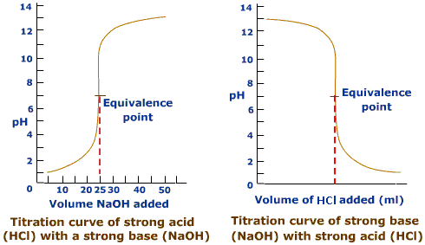
During a titration, the pH does not change in a linear fashion.

Slide 70
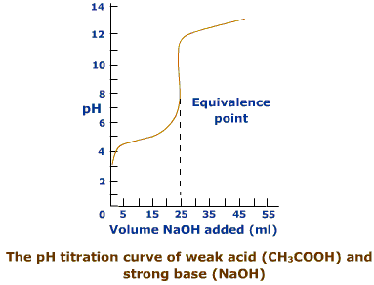
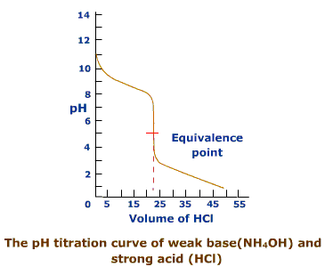

Slide 71
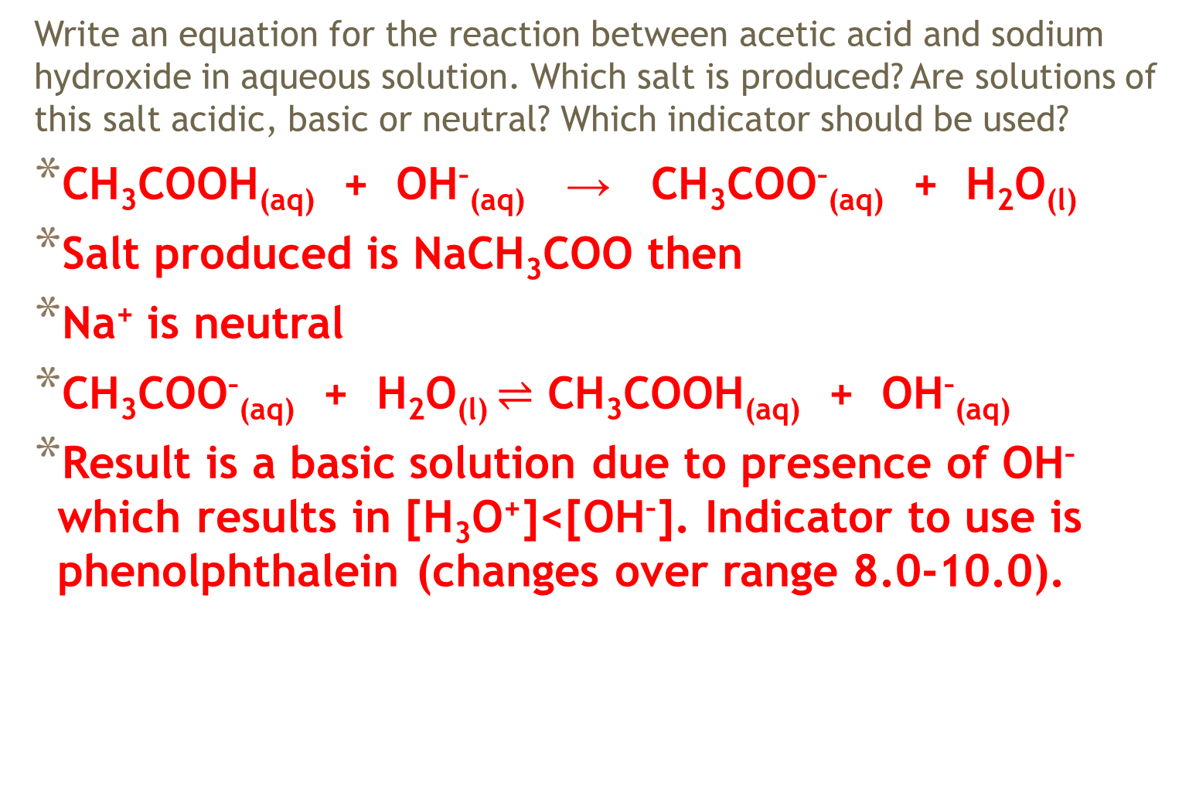
Reactions Between a Weak Acid and a Strong Base
Write an equation for the reaction between acetic acid and sodium hydroxide in aqueous solution. Which salt is produced? Are solutions of this salt acidic, basic or neutral? Which indicator should be used?
CH₃COOH_{(aq)} + OH–_{(aq)} → CH₃COO–_{(aq)} + H₂O_{(l)}
Salt produced is NaCH₃COO then
Na⁺ is neutral
CH₃COO–_{(aq)} + H₂O_{(l)} $⇌$ CH₃COOH_{(aq)} + OH–_{(aq)}
Result is a basic solution due to presence of OH– which results in [H₃O⁺]<[OH–]. Indicator to use is phenolphthalein (changes over range 8.0-10.0).

Slide 72
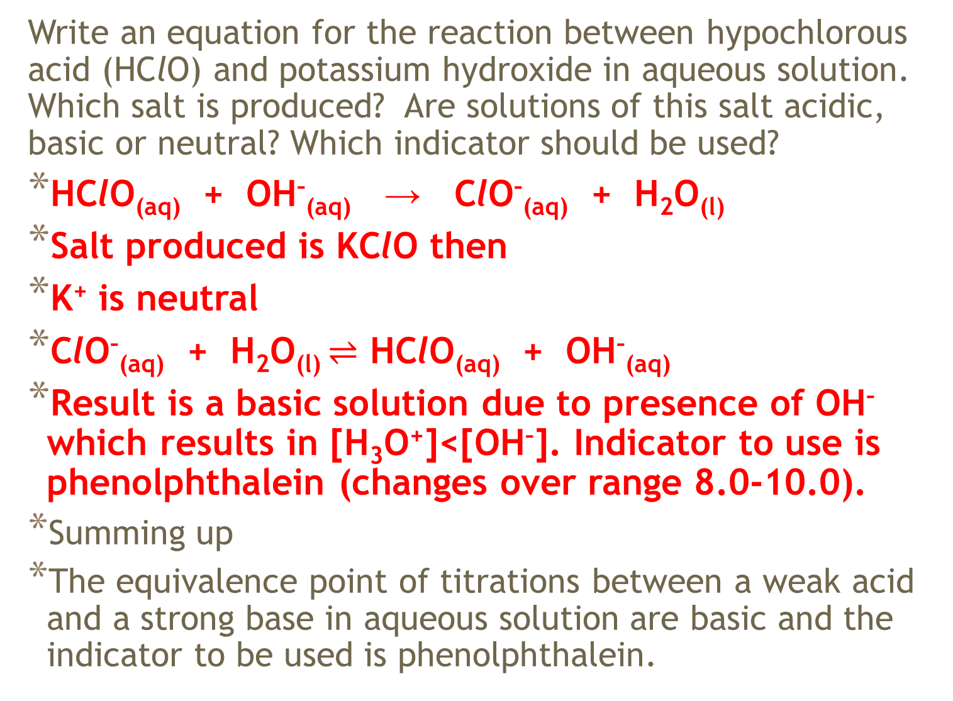
Write an equation for the reaction between hypochlorous acid (HClO) and potassium hydroxide in aqueous solution. Which salt is produced? Are solutions of this salt acidic, basic or neutral? Which indicator should be used?
HClO_{(aq)} + OH–_{(aq)} → ClO–_{(aq)} + H₂O_{(l)}
Salt produced is KClO then
K⁺ is neutral
ClO–_{(aq)} + H₂O_{(l)} $⇌$ HClO_{(aq)} + OH–_{(aq)}
Result is a basic solution due to presence of OH– which results in [H₃O⁺]<[OH–]. Indicator to use is phenolphthalein (changes over range 8.0-10.0).
Summing up
The equivalence point of titrations between a weak acid and a strong base in aqueous solution are basic and the indicator to be used is phenolphthalein.

Slide 73
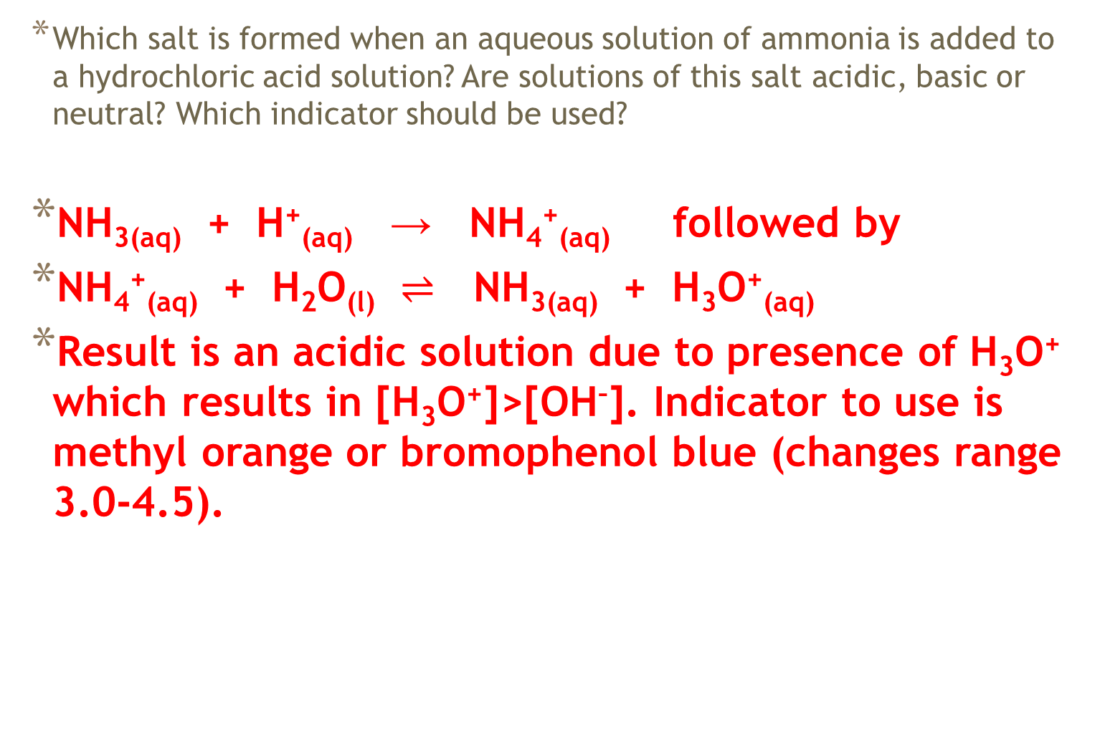
Reactions Between a Strong Acid and a Weak Base
Which salt is formed when an aqueous solution of ammonia is added to a hydrochloric acid solution? Are solutions of this salt acidic, basic or neutral? Which indicator should be used?
NH_{3(aq)} + H⁺_{(aq)} → NH₄⁺_{(aq)} followed by
NH₄⁺_{(aq)} + H₂O_{(l)} $⇌$ NH_{3(aq)} + H₃O⁺_{(aq)}
Result is an acidic solution due to presence of H₃O⁺ which results in [H₃O⁺]>[OH–]. Indicator to use is methyl orange or bromophenol blue (changes range 3.0-4.5).

Slide 74
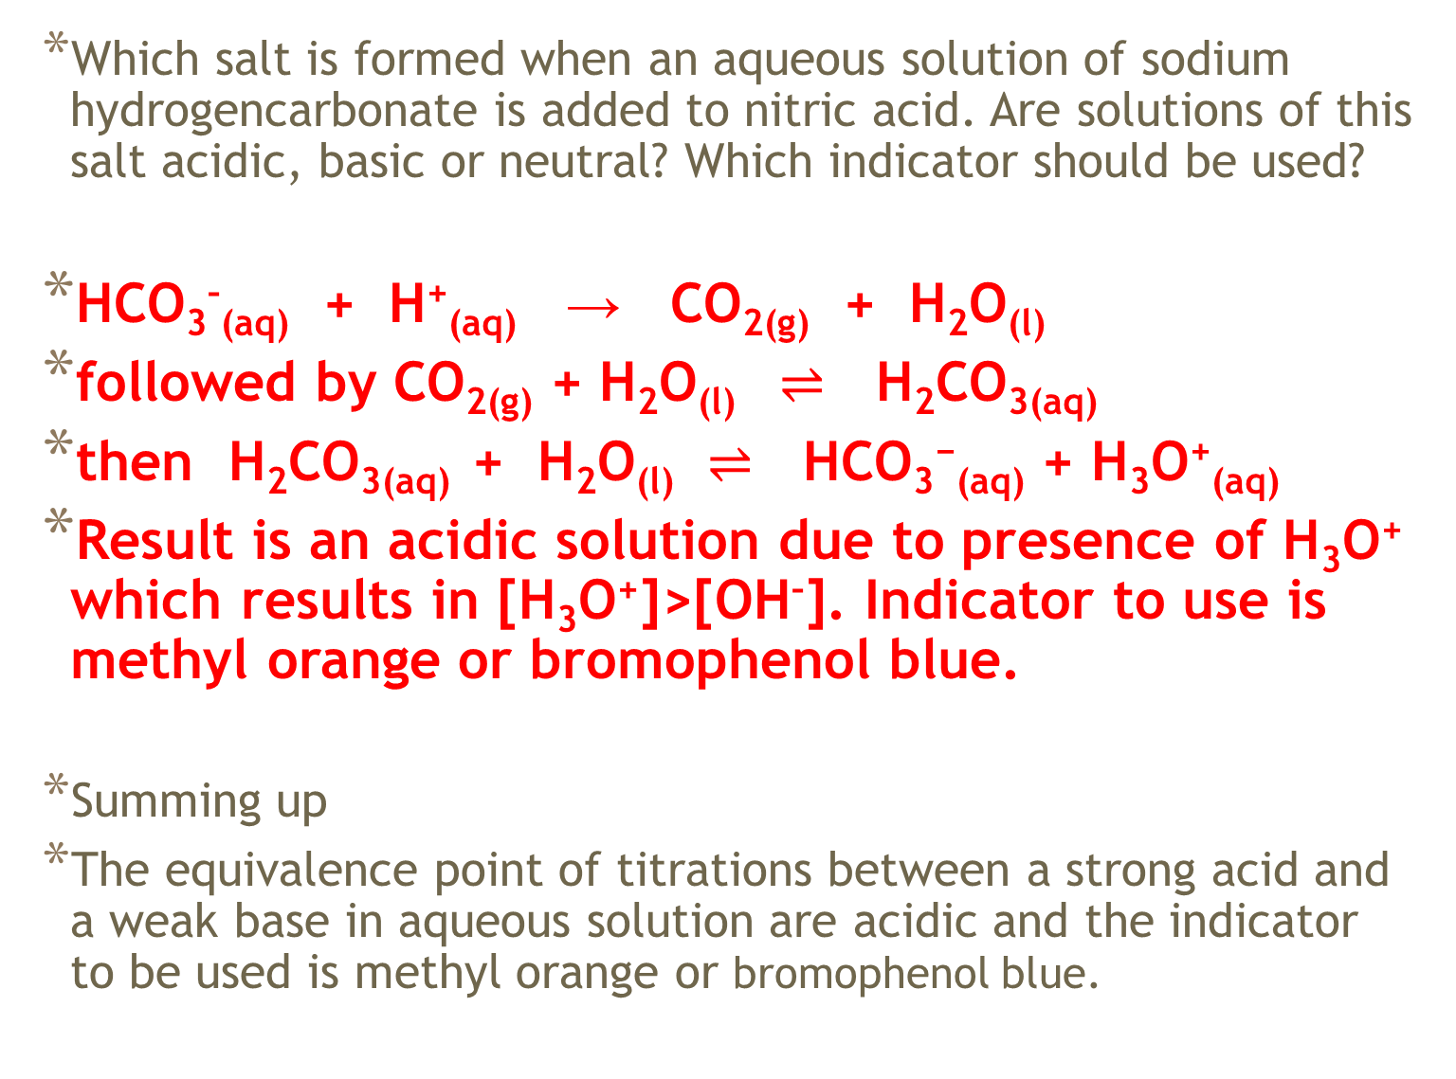
Which salt is formed when an aqueous solution of sodium hydrogencarbonate is added to nitric acid. Are solutions of this salt acidic, basic or neutral? Which indicator should be used?
HCO₃–_{(aq)} + H⁺_{(aq)} → CO_{2(g)} + H₂O_{(l)}
followed by CO_{2(g)} + H₂O_{(l)} $⇌$ H₂CO_{3(aq)}
then H₂CO_{3(aq)} + H₂O_{(l)} $⇌$ HCO₃⁻_{(aq)} + H₃O⁺_{(aq)}
Result is an acidic solution due to presence of H₃O⁺ which results in [H₃O⁺]>[OH–]. Indicator to use is methyl orange or bromophenol blue.
Summing up
The equivalence point of titrations between a strong acid and a weak base in aqueous solution are acidic and the indicator to be used is methyl orange or bromophenol blue.

Slide 75
Reaction Between a Weak Acid and A Weak Base
The reaction between acetic acid and ammonia can be represented by the equation:
CH₃COOH_{(aq)} + NH_{3(aq)} → CH₃COO–_{(aq)} + NH₄⁺_{(aq)}
The pH of solutions of salts such as ammonium acetate depend on the relative strengths of the anion as a base and the cation as an acid. Ammonium acetate solutions are very close to neutral. The equivalence point is not distinct (no great change in pH). As such, a pH meter is definitely the more preferred choice to monitor this type of acid-base titration.

Slide 76
